Slide 1

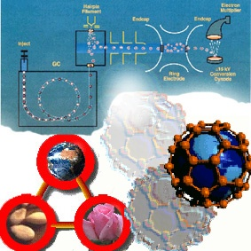

ChE 257
Analytical Chemistry
E.G. Ankudey, PhD
Dept of Chemical Engineering, KNUST

Slide 2
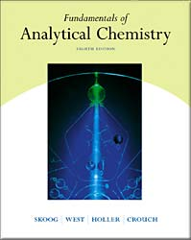
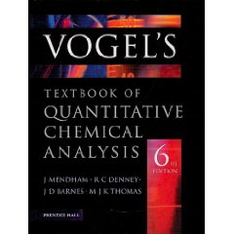
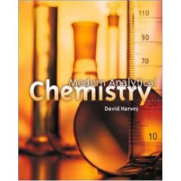
Fundamentals of Analytical Chemistry
8th Edition, © 2004
Douglas A. Skoog , Donald M. West, F. James Holler
Stanley R. Crouch
Vogel’s Quantitative Chemical Analysis
6th Edition, © 2000
J. Mendham , R.C. Denney , J. D. Barnes M.J.K. Thomas
Modern Analytical Chemistry
© 2000
David Harvey

Slide 3

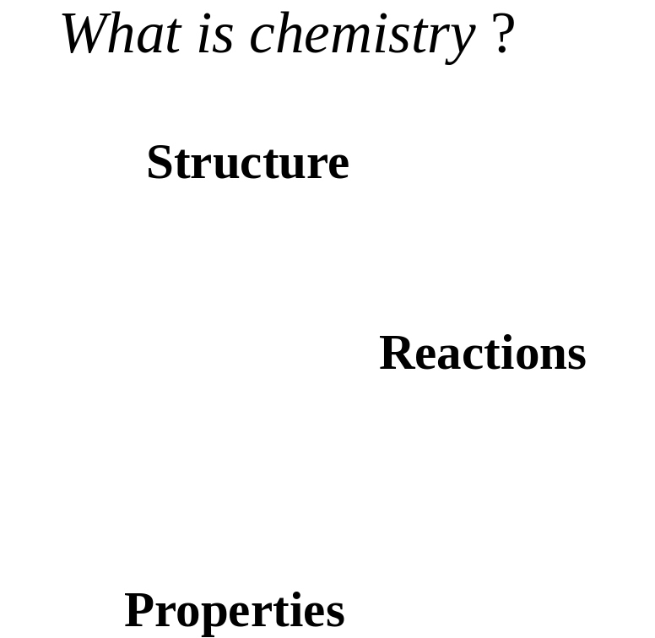
Introduction
Chemistry (kem'is tree): noun.
The science in which substances are examined to find out what they are made of, how they act under different conditions, and how they are combined or separated to/from other substances.
In other words, chemistry deals with finding what different substances are made of, what kind of transformations take place, and different chemically related facts about a certain organism or substance.

Slide 4

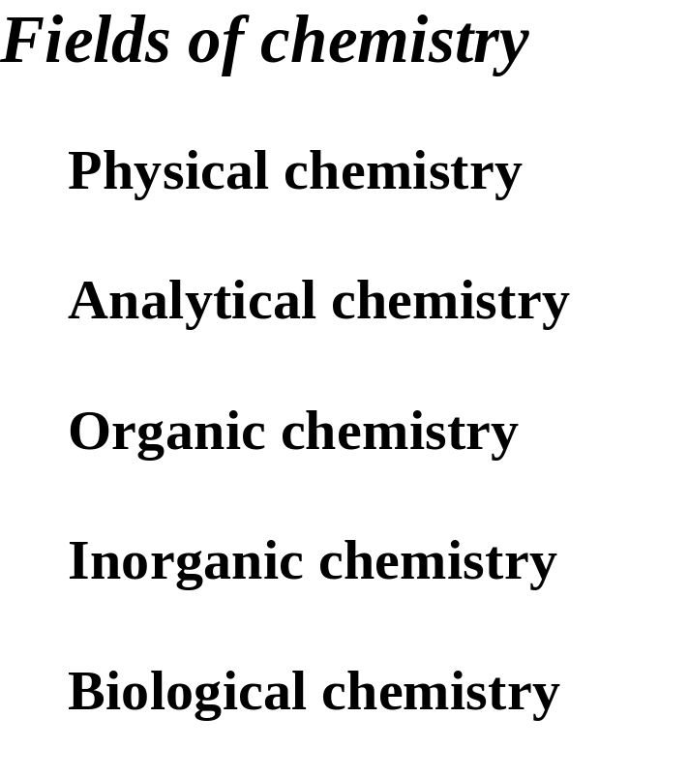
Introduction

Slide 5
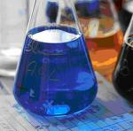
What is Analytical Chemistry ?
Analytical chemistry deals with separating, identifying, and quantifying the relative amounts of the components of an analyte.
Analyte = the constituent of interest in a sample; the component(s) of a sample that are to be determined.

Slide 6
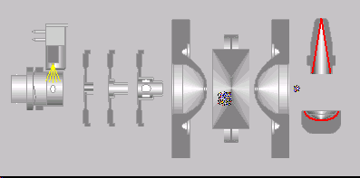
What is analytical chemistry ?
Qualitative analysis :
What is present ?
Determination of chemical identity of the species in the sample.
Quantitative analysis :
How much present ?
Determination of the amount of species or analytes, in numerical terms. Hence, math is heavily involved. In order to perform quantitative analysis, typically one needs to complete qualitative analysis. One needs to know what it is and then select the means to determine the amount.
Instrumental analysis

Slide 7
The role of analytical chemistry:
central science
Chemistry : Biological, Inorganic, Organic, Physical
Physics : Astrophysics, Astronomy, Biophysics
Biology : Botany, Genetics, Microbiology, Molecular biology, Zoology
Geology : Geophysics, Geochemistry, Paleontology, Paleobiology
Environmental science : Ecology, Meteorology, Oceanography
Medicine : Clinical, Medicinal, Pharmacy, Toxicology
Material science : Metallurgy, Polymers, Solid state
Engineering : Civil, Chemical, Electronical, Mechanical
Agriculture : Agronomy, Animal, Crop, Food, Horticulture, Soil
Social Science : Archeology, Anthropology, Forensics
Analytical
chemistry

Slide 8
Several different areas of analytical chemistry
Clinical analysis - blood, urine, feces, cellular fluids, etc., for use in diagnosis.
Pharmaceutical analysis - establish the physical properties, toxicity, metabolites, quality control, etc.
3. Environmental analysis - pollutants, soil and water analysis, pesticides.
4. Forensic analysis - analysis related to criminology; DNA finger printing, finger print detection; blood analysis.
5. Industrial quality control - required by most companies to control product quality.
6. Bioanalytical chemistry and analysis - detection and/or analysis of biological components (i.e., proteins, DNA, RNA, carbohydrates, metabolites, etc.).
This often overlaps many areas.
Develop new tools for basic and clinical research.

Slide 9
Classification of Quantitative Methods of Analysis
Gravimetric Method: mass is measured.
Volumetric Method: volume is measured or used to determine amount of sample via concentration.
Instrumental Method: use an instrumental technique to assay the amount of sample e.g. Electroanalytical based upon electron-transfer and
Spectroscopy including mass spectrometry

Slide 10
Miscellaneous analytical methods
Mass spectrometry - mass-to-charge ratio of an analyte's decomposition products.
Radiochemical methods - measuring rates of radioactive decay by an analyte.
3. Kinetics - measuring reaction rates.
4. Thermal conductivity.
5. Optical activity - measuring the interactions of an analyte with plane-polarized light.
6. Refractometry / Refractive index.

Slide 11
Methods of Detecting Analytes
Physical means
  mass
  color
  refractive index
  thermal conductivity
with electromagnetic radiation (Spectroscopy)
  absorption
  emission
  scattering
by an electric charge
  electrochemistry
  mass spectrometry
There are a limited number of ways to detect an analyte. However, in each of the above general categories there are a large multitude of specific analytical techniques.

Slide 12
Steps in a Typical Quantitative Analysis
1. Select a method: accuracy, reliability, time and cost, complexity of sample
e.g., blood samples, pharmaceutical products.
2. Sampling: obtaining “a representative sample”, especially important for mass products.
3. Sample preparation and handling
  a) Dissolution or digestion of samples
  Avoiding decomposition conditions. This is
  especially troublesome for biological samples.
  b) Preparation of solid samples :
  Solids are usually ground to a suitable particulate
  size to get a homogeneous sample.

Slide 13
Steps in a Typical Quantitative Analysis
  4. Define replicate sample: accuracy, reliability and cost
5. Eliminating interferences: blank control
6. Calibration and measurement C_{A}= kX
7. Calculation and data reduction
8. Evaluating results and estimating their reliability
This requires appropriate use of statistics.
An analytical result without an estimate of reliability is of no value.

Slide 14
Specificity and Selectivity
Techniques or reactions that work for only one analyte are said to be specific.
Techniques or reactions that apply for only a few analytes are selective.
Matrix
The matrix or sample matrix is all of the components in the sample containing an analyte.

Slide 15
What is analytical chemistry ? Summary
<Result set> = {S, [C_{i}]₁^{n}, [Q_{i}] ₁^{n}, [A_{i}] ₁^{n}, T}
where S = matrix system, C_{i} = species, Q_{i} = quantity, A_{i} = accuracy, T = time
Source : Philip Barker : Computers in analytical chemistry

Slide 16

Calculations used in analytical chemistry

Slide 17
The Metric System
a. Invented by French scientists in 1795
b. Based on powers of 10
c. SI (International System of Units)
Fundamental Units
a. Time
1) Unit is the second
2) First defined as 1/86 400 of the mean solar day
3) Now defined as the frequency of a type of radiation emitted
by cesium-133

Slide 18
b. Length
1) Unit is the meter
2) First defined as one ten-millionth (10⁻⁷) of distance from
north pole to equator through Lyons, France
3) Redefined in 1960 as a multiple of a wavelength of light
emitted by krypton-86
4) Redefined again in 1982 as the distance light travels in
1/299 792 458 second in a vacuum
c. Mass
1) Unit is the kilogram
2) The only unit not defined in terms of atoms
3) It is the mass of a platinum-iridium metal cylinder kept in
Sevres, France
http://www.setterfield.org/history.htm#minimum http://www.kriss.re.kr/new2004/standard/mass_1.jsp

Slide 19
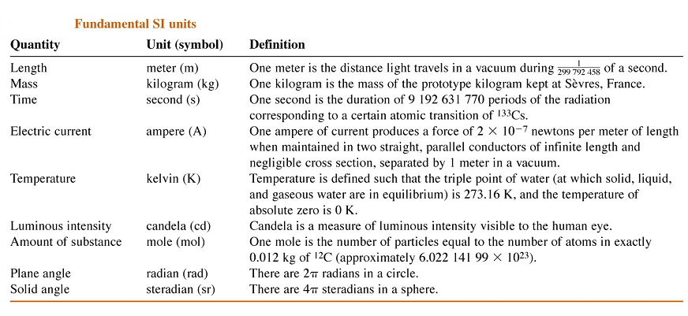
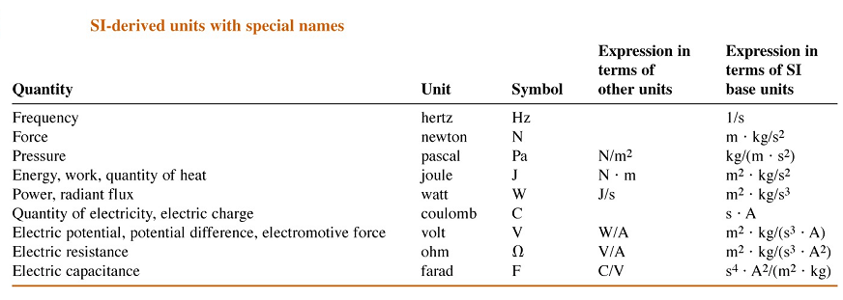
International system of unit ( Systeme International d’Unites), 1960

Slide 20
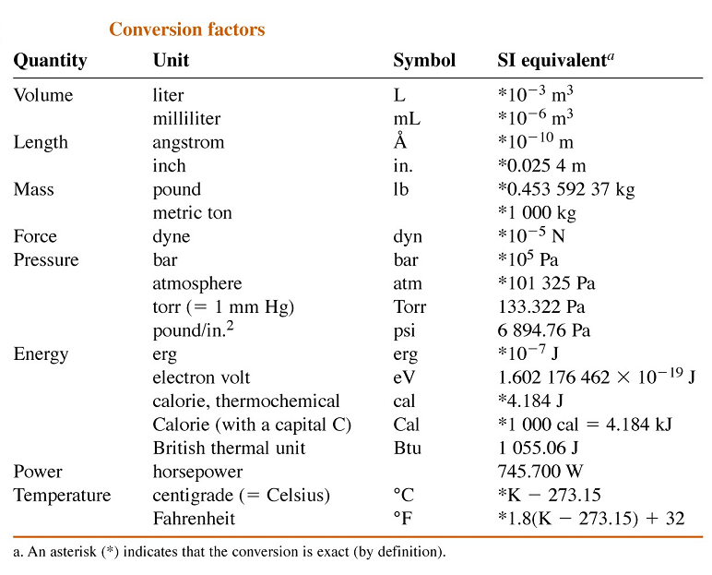

Slide 21
Prefix of units
Prefix | Symbol | Factor | Prefix | Symbol | Factor
Yotta | Y | 10²⁴ | Deci | d | 10^{–1}
Zetta | Z | 10²¹ | Centi | c | 10^{–2}
Exa | E | 10¹⁸ | Milli | m | 10^{–3}
Peta | P | 10¹⁵ | Micro | μ | 10^{–6}
Tera | T | 10¹² | Nano | n | 10^{–9}
Giga | G | 10⁹ | Pico | p | 10^{–12}
Mega | M | 10⁶ | Femto | f | 10^{–15}
Kilo | k | 10³ | Atto | a | 10^{–18}
Hecto | h | 10² | Zepto | z | 10^{–21}
Deca | da | 10 | Yocto | y | 10^{–24}

Slide 22
Example
590nm = 590×10⁻⁹ m = 5900 Å
20 μL = 20 ×10⁻⁶ L
6 pmol = 6×10⁻¹² mol
20Gbite = 20×10⁹ bite
1 mL = 10⁻⁶ m³ = 1cm³

Slide 23
Expression of concentration
1) Molarity :
M = (moles of solute) / (liter of solution)
= (mmoles) / (ml)
A mole is defined as the number of atoms of ¹²C in exactly 12g of ¹²C (12 amu or daltons).
Avogadro’s number = 6.0221438×10²³.
A mole of a chemical species is 6.0221438×10²³ atoms, molecules, ions, electrons, ion pairs, or subatomic particles.

Slide 24
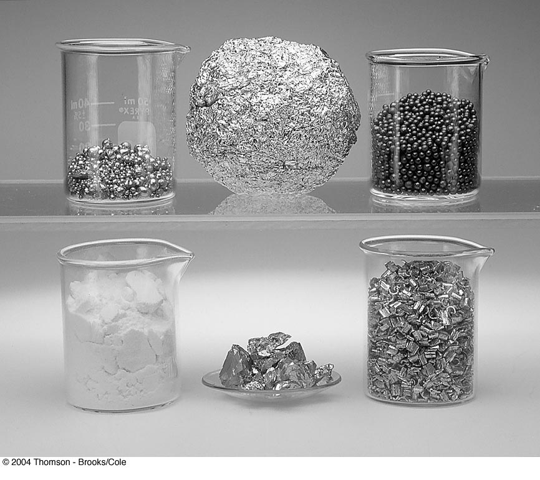
Approximately 1 mole of each of several different elements.
Clockwise from the upper left:
64 g of copper beads,
27 g of crumpled aluminum foil,
207g of lead shot,
24 g of magnesium chips,
52 g of chromium chunks, and
32 g of sulfur powder:
The beakers in the photo have a volume of 50 mL.

Slide 25
Example
Chlorine (Cl) atomic wt = 35.453
1g atom = 35.453g
wt of one Cl atom =35.453g/6.0221438×10²³
= 5.887×10⁻²³g
Cl₂ 1g molecule = 1 mol = 35.453g× 2
= 70.906g
Glucose: C₆H₁₂O₆
1M C₆H₁₂O₆ = (12.0g/mol C) × (6 mol C/mol C₆H₁₂O₆ )
+ (1.0g/mol H) × (12 mol H/mol C₆H₁₂O₆ )
+ (16.0g/mol O) × (6 mol O /mol C₆H₁₂O₆ )
= 180.0 g / mol C₆H₁₂O₆

Slide 26
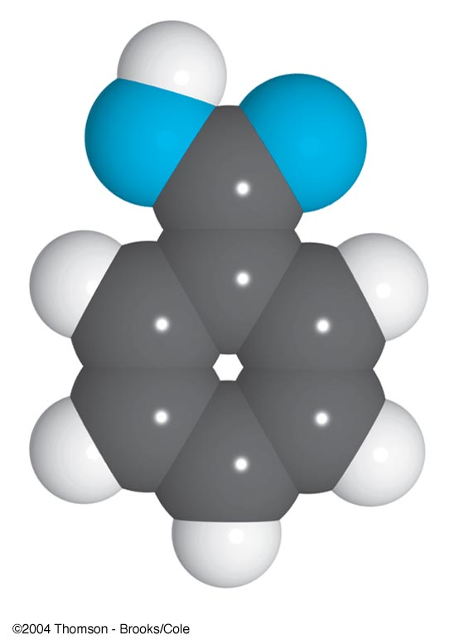
Example
Benzoic acid
C₆H₅COOH
1 mole = 122.1 g
x mole = y mmol = 2.00 g
x = 0.0164 mol
y = 16.4 mmol

Slide 27
Example
How many grams of Na⁺ (22.99g/mol) are contained in 25.0 g of Na₂SO₄ (142.0 g/mol) ?
1 mol of Na₂SO₄ contains 2 mol of Na⁺ .
Na₂SO₄ 1 mol = 142.0 g
x mol = 25.0 g x = 25.0 g / 142.0 g = ?
Na⁺ 1 mol = 22.99 g
2 x mol = y g y = 8.10 g

Slide 28
Analytical or Equilibrium
Analytical molarity is the total number of moles of a solute, regardless of its chemical state, in 1 L of solution. The analytical molarity describes how a solution of a given molarity can be prepared.
Equilibrium molarity is the molar concentration of a particular species in a solution.
Ex. 1.0 M H₂SO₄
[H₂SO₄] = 0.00 M [H⁺] = 1.01 M
[HSO₄–] = 0.99 M [SO₄^{–2} ] = 0.01 M
Analytical molarity of H₂SO₄ is given by c _{H2SO4} = [HSO₄–] + [SO₄^{–2} ]

Slide 29
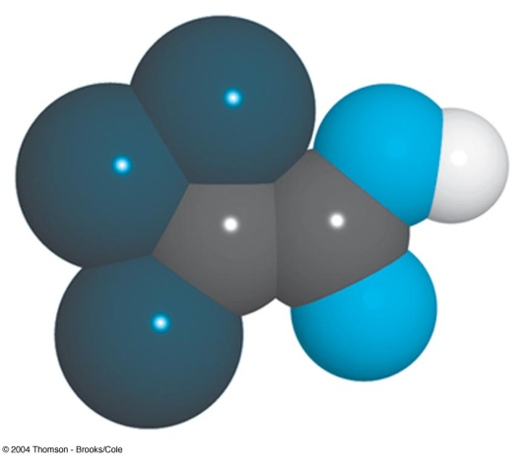
Example
Calculate the analytical and equilbrium molar concentrations of the solute species in an aqueous solution that contains 285 mg of trichloroacetic acid, Cl₃CCOOH (163.4 g/mol), in 10.0 mL (the trichloroacetic acid is 73% ionized in water).
Cl₃CCOOH = HA 163.4 g = 1 mol
285 mg = x mol x = 1.744 ×10⁻³ mol
Analytical concentration :
163.4 g / 1000 mL = 1 M
285 mg / 10.0 mL = y M y = 0.174 M

Slide 30
Equilibrium concentration:
HA ↔ H⁺ + A–
initial 1 0 0
Final 1–0.73 0.73 0.73
[HA] = y M × (1 – 0.73) = 0.174 × 0.27 = 0.047 M
[H⁺] = [A–] = y M × 0.73 = 0.127 M

Slide 31
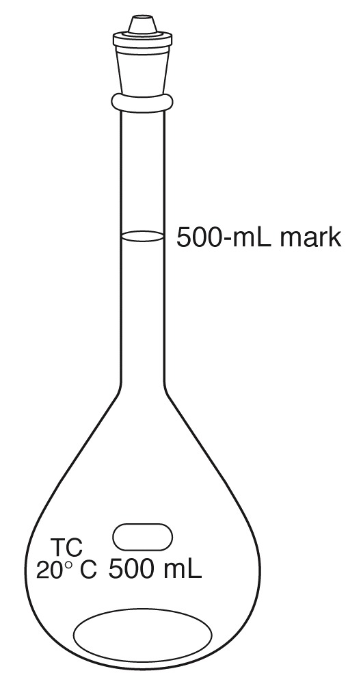
Example
Describe the preparation of 500 mL of 0.108 M BaCl₂ from BaCl₂•2H₂O (244.3 g/mol).
BaCl₂•2H₂O 1 mol ≡ BaCl₂ 1 mol
244.3 g / 1000 mL = 1 M
x g / 500 mL = 0.108 M x = 13.2 g
A volumetric flask contains a special volume
when the liquid level is adjusted to the middle
of the mark in the thin neck of the flask.

Slide 32
2) Formality ; formal or analytical concentration
F = the number of moles of a species regardless of chemical
form per liter of solution
Strong electrolyte : completely dissociated
Ex. NaCl mol wt 58.44 g/L = 1 M
2.7g/100mL sea water = x M
x = 0.46M = 0.46F
Weak electrolyte : partially dissociated
Ex. HAC 0.1 F (1.3% dissociated)

Slide 33
Normality
Normality is an older unit of concentration. It is the number of equivalents of solute per liter of solution.
The equivalent is the amount of one chemical species reacting stoichiometrically with another chemical species defined as the moles of a species that can donate one reaction unit.
Note: equivalent and normality are functions of the
chemical reaction in which the species participates.
Example: A solution of H₂SO₄
has a fixed molarity, its normality depends on how it reacts.

Slide 34
In a precipitation reaction, the reaction unit is the charge of the cation or anion involved in the reaction.
Pb²⁺(aq) + 2I–(aq) PbI₂(s)
n = 2 for Pb²⁺ and n = 1 for I–.
In an acid–base reaction, the reaction unit is the number of H+ ions donated by an acid or accepted by a base.
H₂SO₄(aq) + 2NH₃(aq) 2NH⁴⁺(aq) + SO₄^{2–} (aq)
n = 2 for H₂SO₄ and n = 1 for NH₃.
Normality is the number of equivalent weights (EW) per unit volume
An equivalent weight is defined as the ratio of a chemical species’ formula weight (FW) to the number of its equivalents
N = n x M

Slide 35
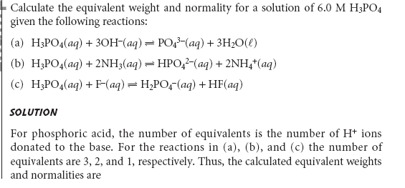
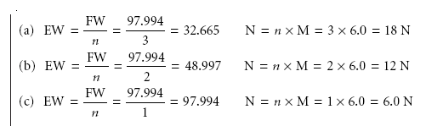
Example

Slide 36
Molality m = (mol solute) / (kg solvent)
Used in thermodynamic calculations to express concentrations that are temperature independent
4) Percent composition
% = Weight % = w/w %
= {(mass of solute) / (mass of solution)} × 100
Volume % = v/v %
= {(volume of solute) / (volume of solution)} × 100
Weight / volume percent = w/v %
= {(weight of solute, g) / (volume of solution)} × 100

Slide 37
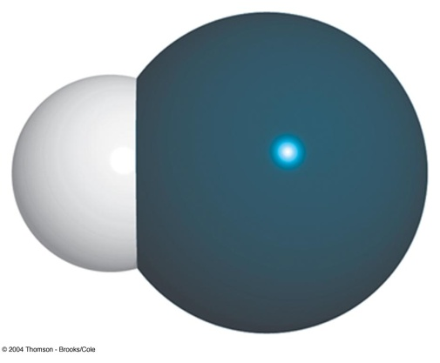
Example
Converting weight percent to molarity
37.0 wt% HCl d = 1.188 g/ml
1) Molarity ? 2) Volume of 37.0% HCl to prepare 0.1M HCl ?
HCl: 36.461 g / 1000ml = 1M
37.0g / {100g/(1.188g/ml)} = x M
∴ x = 12.0556 M ≈ 12.0556 N
MV = M’V’
12.0556N ×Vml = 0.1M ×1000ml
∴V = 8.2949 ml ≈ 8.3 ml

Slide 38
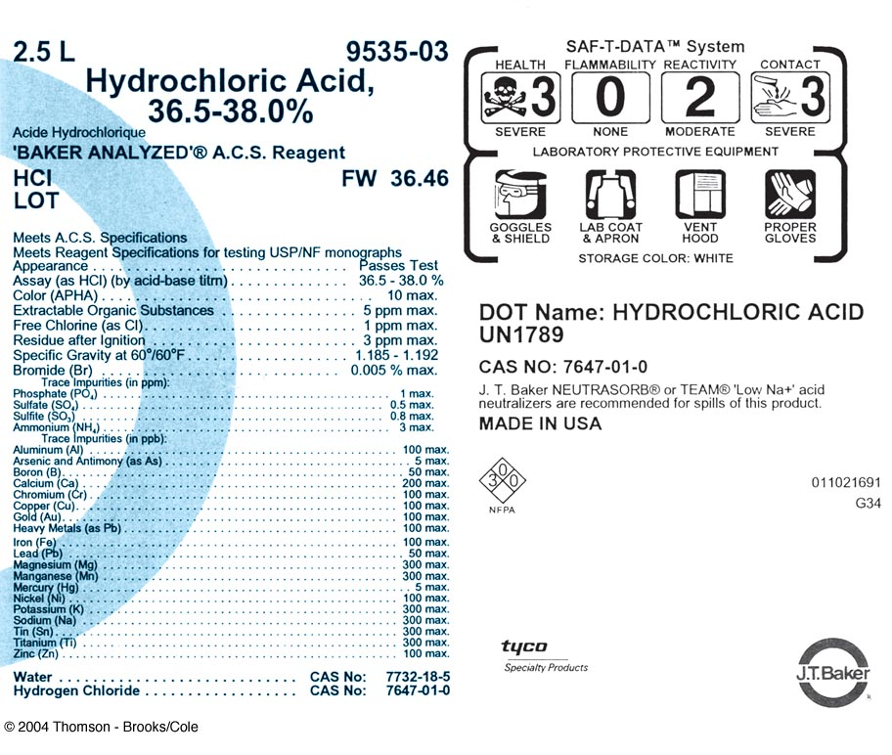

Slide 39
Parts per million
ppm = (g/g) ×10⁶ = mg/kg = μg/g
ppm (wt/v) = mg/L = μg/mL
Parts per billion
ppb = (g/g) ×10⁹ = μg/L
Parts per thousand
ppt = (g/g) ×10³

Slide 40
Osmolarity
Osm = (moles of particles) / (liters of soln)
Example
5%(wt/v) Dextrose injectable fluid
C₆H₁₂O₆ = C₆H₁₂O₆
(mol wt.=180.16) 180.16g/1000mL = 1M = 1 Osm
5g/100mL = x Osm
∴ x = 0.2775 Osm
0.9%(wt/v) Saline solution
NaCl = Na⁺ + Cl⁻
m.w. 58.45 58.45g/1000mL = 1M = 2 Osm
0.9g/100mL = x Osm
∴ x = 0.308 Osm

Slide 41
p-function
The p-value is the negative logarithm (to the base 10) of the molar concentration of that species.
pX = – log [X]
Example
5.4 × 10^{–4} M HCl pH = ?
pH = – log [H⁺] = – log 5.4 × 10^{–4} =3.27
2) 2.00 × 10^{–3} M NaCl pCl = ?
pCl = – log [Cl –] = – log 2.00 × 10^{–3} =2.699
pAg = 6.372 [Ag⁺] = ?
pAg = – log [Ag⁺] = 6.372
log [Ag⁺] = – 6.372 [Ag⁺] = 4.246 × 10^{–7} ≈ 4.25 × 10^{–7}

Slide 42
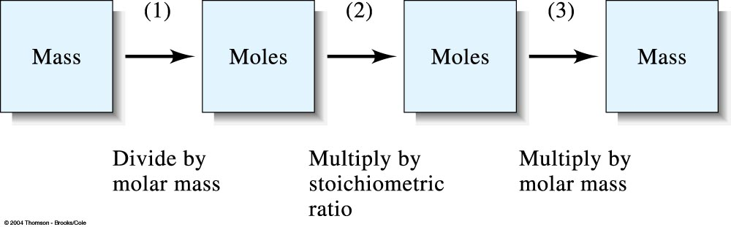
Stoichiometric calculation
Example: What mass of AgNO₃(mw=169.9) is needed to convert 2.33g of Na₂CO₃ (mw=106.0) to Ag₂CO₃ (mw= 275.7) ?
2AgNO₃ + Na₂CO₃ → Ag₂CO₃ + 2NaNO₃
AgNO₃ 2 mol = 2×169.9g ≡ Na₂CO₃ 1 mol = 106.0 g
y g ≡ x mol = 2.33g
∴ x mol = 0.02198 mol y = 169.9 g × 2 × 0.02198 mol = 7.47 g

Slide 43
Sampling, Standardization, and Calibration

Slide 44
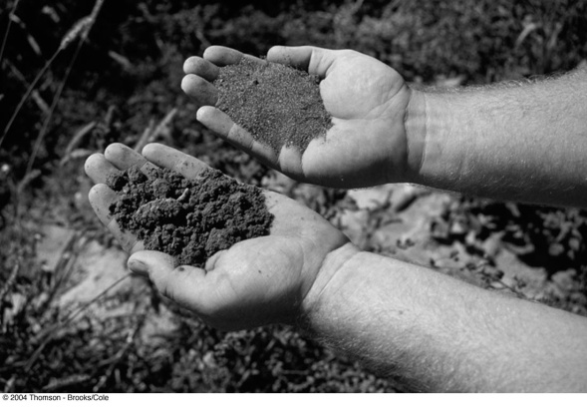

Sampling is one of the most important operations in a chemical analysis.
Chemical analyses use only a small fraction of the available sample. The fractions of the samples that collected for analyses must be representative of the bulk materials.
Knowing how much sample to collect and how to further subdivide the collected sample to obtain a laboratory sample is vital in the analytical process.
All three steps of sampling, standardization, and calibration require a knowledge of statistics.

Slide 45
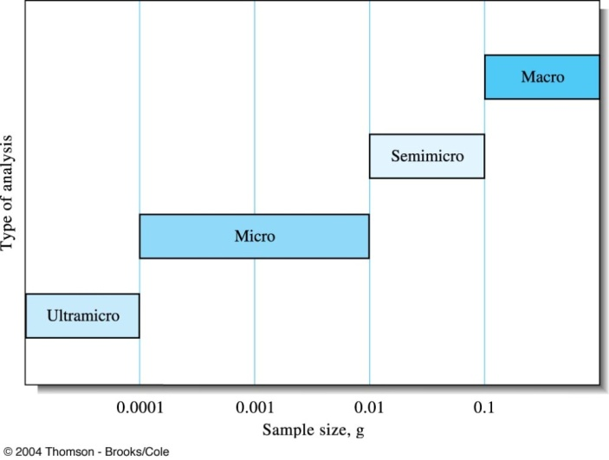
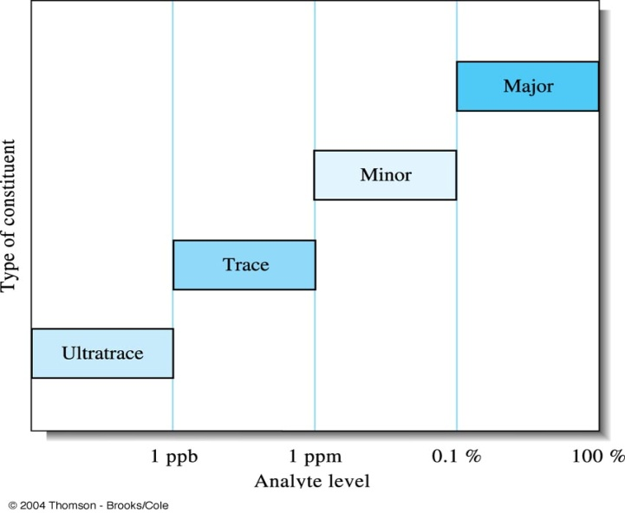
Analytical samples and methods
Sample size Type of analysis
> 0.1g Macro
0.01~0.1g Semimicro
0.0001~0.01g Micro
< 10^{–4} g Ultramicro
Analytical level Type of constituent
1%~100% Major
0.01%(100ppm)~1% Minor
1ppb~100ppm Trace
<1 ppb Ultratrace

Slide 46
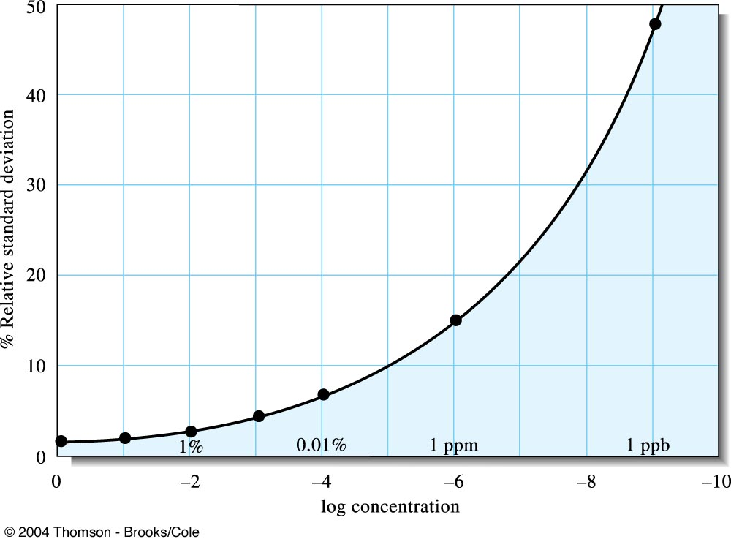
Interlaboratory error as a function of analyte concentration. Note that the relative standard deviation dramatically increase as the analyte concentration decreases.
W. Horowitz, Anal. Chem., 1982, 54, 67A-76A.

Slide 47
Real Samples
Matrix is the medium containing analyte.
A matrix effect is a change in the analytical signal caused by anything in the sample other than analyte.
Sample are analyzed, but constituents or concentrations are determined.

